Slide 1
I see your results – how hard was your data?

Slide 2
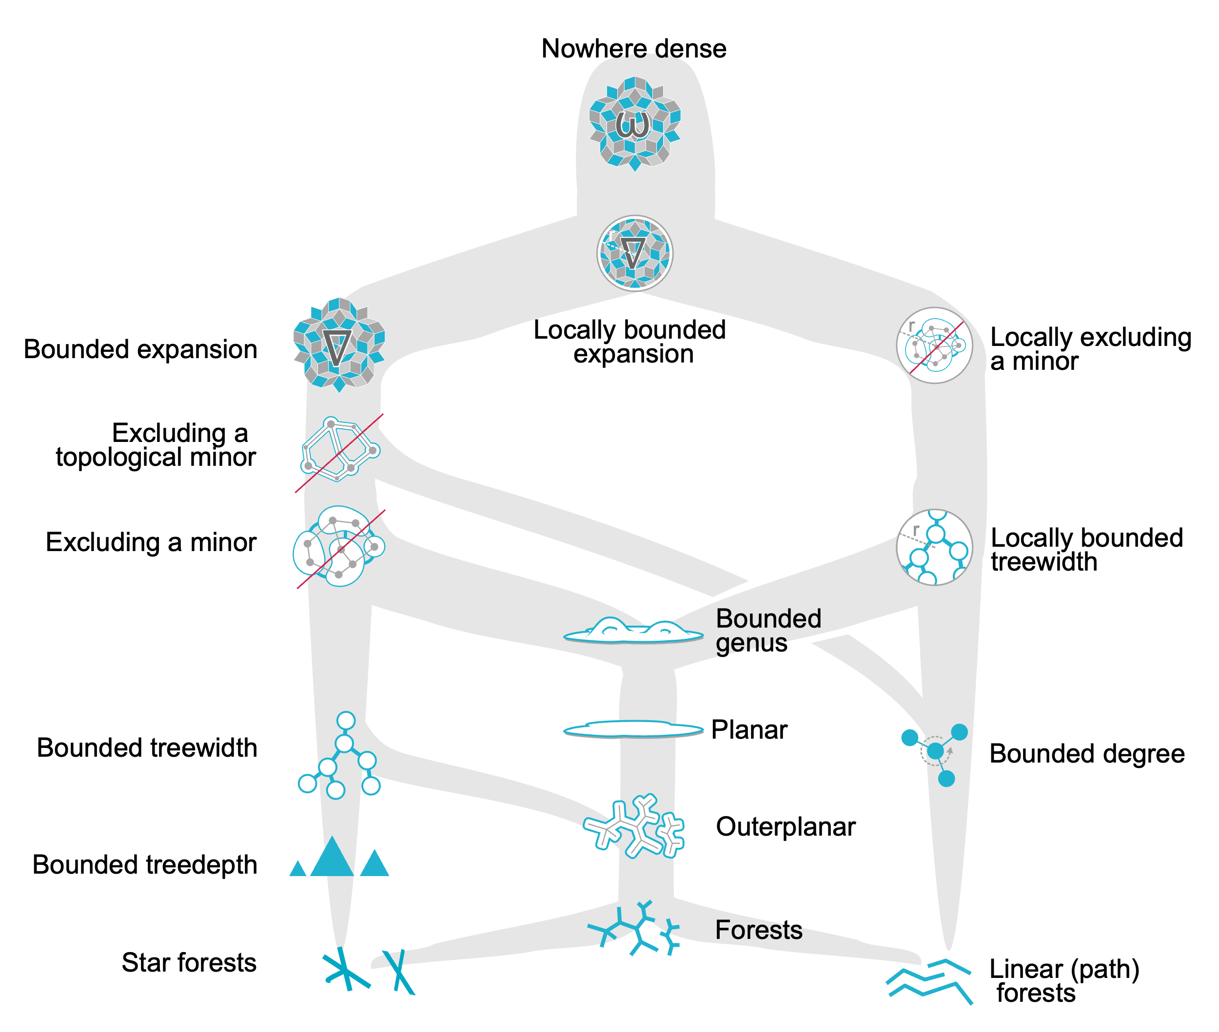
Hierarchy of “complexity”/niceness – for `Sparse’ graphs
Slightly modified from diagram of Felix Reidl – circa 2020

Slide 3
Hierarchy of “complexity”/niceness – for `Sparse’ graphs
Very, Very, Very nice – trivial to deal with
For example, max clique size is 2; finding a maximal clique is equiv to merely finding an edge
Slightly modified from diagram of Felix Reidl – circa 2020

Slide 4
Hierarchy of “complexity”/niceness – for `Sparse’ graphs
Still – “nice” – fixed parameter tractable for example
Very, Very, Very nice – trivial to deal with
Slightly modified from diagram of Felix Reidl – circa 2020

Slide 5
Hierarchy of “complexity”/niceness – for `Sparse’ graphs
Still – “nice” – fixed parameter tractable for example
Very, Very, Very nice – trivial to deal with
Slightly modified from diagram of Felix Reidl – circa 2020
“Nicety”
(more properties to exploit)

Slide 6
Hierarchy of “complexity”/niceness – for `Sparse’ graphs
Expressivity/Complexity
Still – “nice” – fixed parameter tractable for example
Very, Very, Very nice – trivial to deal with
Slightly modified from diagram of Felix Reidl – circa 2020
“Nicety”

Slide 7
Hierarchy of “complexity”/niceness – for `Sparse’ graphs
Expressivity/Complexity
Still – “nice” – fixed parameter tractable for example
Very, Very, Very nice – trivial to deal with
Slightly modified from diagram of Felix Reidl – circa 2020
Where do my problems/data sit?
“Nicety”

Slide 8
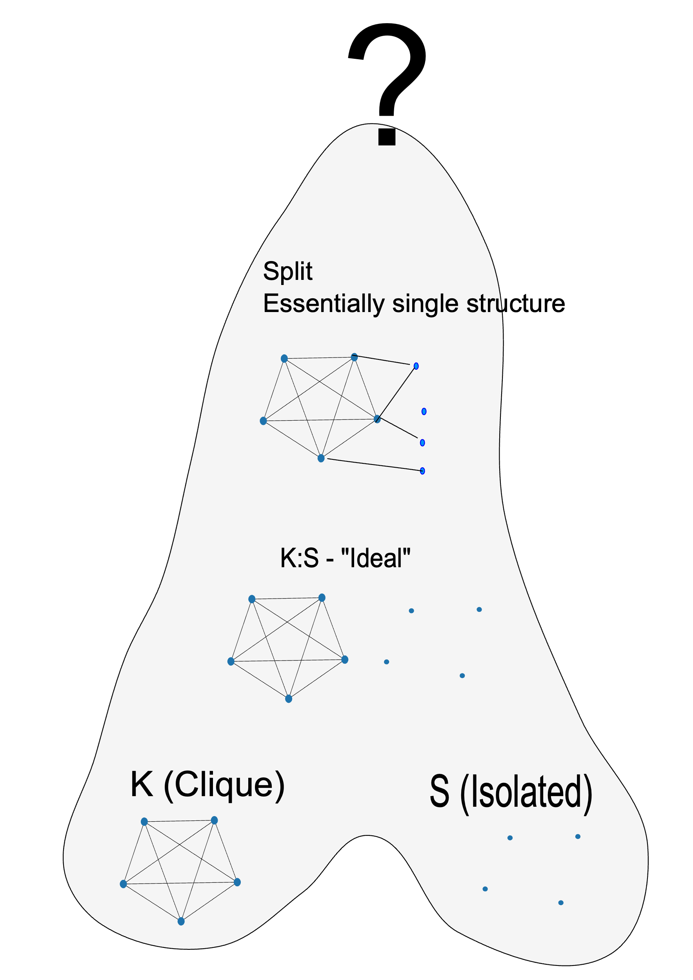
Cliques (of arbitrary large size) cannot belong to “nowhere dense” classes.
(And
Straightforward generalizations to hypergraphs)

Slide 9
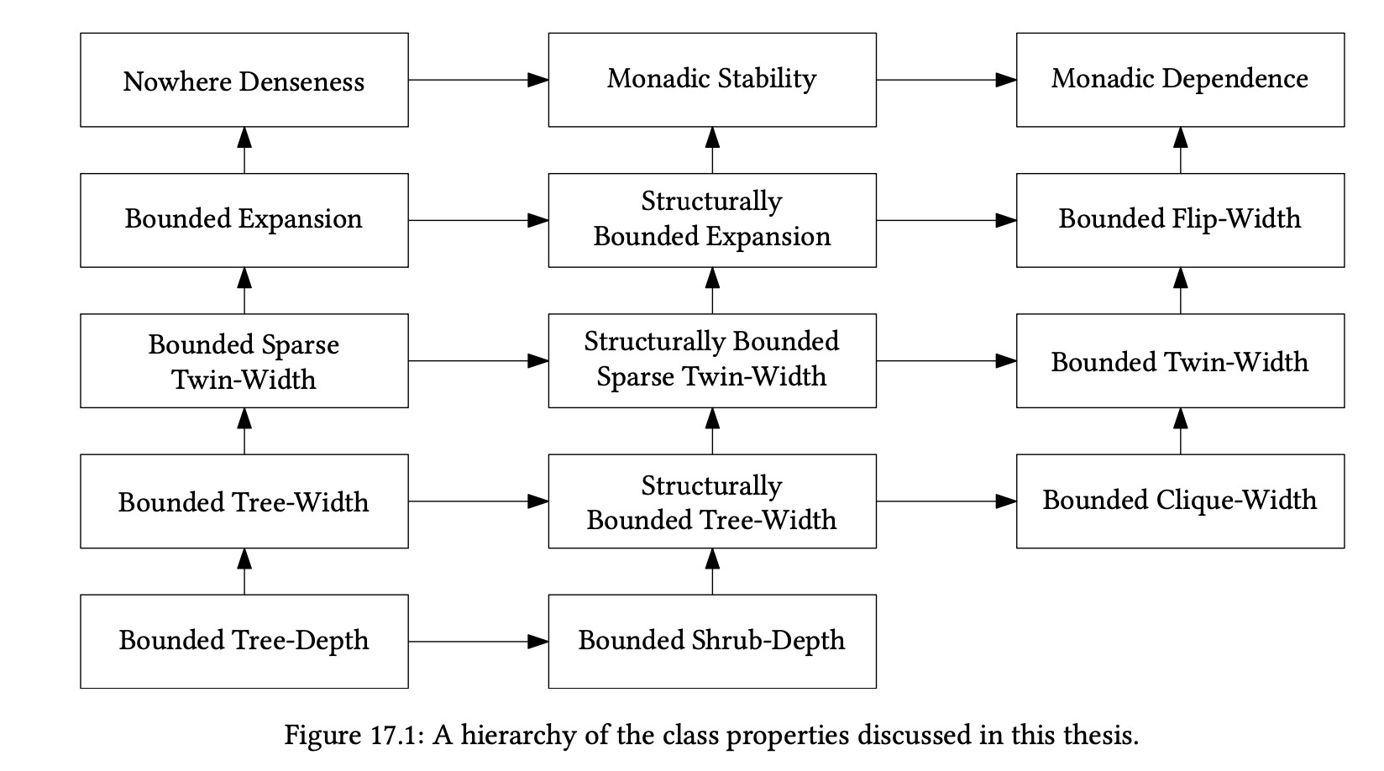
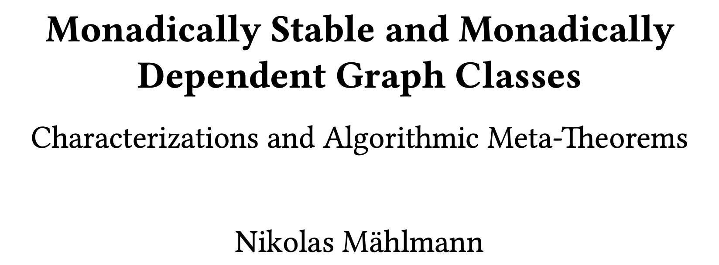


Slide 10
Very, Very, Very, Very special

Slide 11

Very, Very, Very, Very special
Still quite special!

Slide 12

Very, Very, Very, Very special
Still quite special!
But where does “my” data sit???

Slide 13


(planar)
(map)
Very, Very, Very, Very special
Can’t be here…as must contain cliques of arbitrary size
Still quite special!
But where does “my” data sit???

Slide 14


(planar)
(map)
(Nesetril 2021)
Very, Very, Very, Very special
Can’t be here…as must contain cliques of arbitrary size
Still quite special!
But where does “my” data sit???

Slide 15
Interval graphs can have unbounded clique width…
So SOME of “my data” can be “worse” than if the class had bounded clique width.
But…how bad?
Does the interval graph class
Have bounded twin-width?
bounded flip-width?
Is it a class with monadic dependence?
Very, Very, Very, Very special
Esssentially Yes!
Note also that cographs have twin-width 0 – so “most” bounded twin width
So threshold graphs (which are a subset of cographs) have bounded twin width.
Interval-intersect-cograph - quasithreshold
Still quite special!
But where does “my” data sit???

Slide 16


UNIT interval graphs have bounded twin width (<=2) but unbounded clique width
(Eppstein slides)
Quasi-threshold (cograph intersect interval) have twin-width zero
K:S (Ideal) – and Threshold
Very, Very, Very, Very special
Still quite special!
But where does “my” data sit???

Slide 17
Classifying the difficulty of data…
As illustrated on graphclasses.org…if your problem is in some way related to a graph formulated problem – then a lot is already known about the difficulty of solving problems on that graph class….
BUT that information is basically “classical complexity theory”: polynomial or exponentially hard (which only captures one aspect – not nuanced gradation of difficulty) – and for ALL algorithms (typically not for a class of algorithms etc.). More recent computational complexity theory looks at finer gradations in computational cost + at classes of algorithms - ”fine grained complexity”
Some of my recent work and interest seems to fall into this new area of interest – albeit restricted to my problems/methods of interest…

Slide 18
The era of algorithm leaderboards…and deep learning…
Typically a new idea is tested on some synthetic data (where in principle you can control the complexity - but as we see later – maybe not so clearly controlled – and generally know the “right answer”). But the main interest is on how it performs on real data and against the current “challenging data sets”. Leaderboards of ranked performances of recently proposed and older approaches “benchmark” the success of a new approach
In some sense, this is what started the new generation of AI – the collection of challenging data (for both training and testing…Imagenet) and the “astounding success” of a deep learning approach on that dataset
Careers (and money) are made on having an algorithm at the top of a leaderboard…

Slide 19
The era of algorithm leaderboards…and deep learning…
So what is wrong with such an approach to selecting good solution methods…
Well it *is* better than “weaker testing” (not comparing algorithms fairly and on the same dataset(s) – just reporting the results on your own special data etc.
But…
It can lead to overtuning to the data set….with or without realizing it….
It can lead to declaring winners on tiny margins that really aren’t that meaningful (although the “community” will usually begin to declare that dataset no longer challenging enough and go for a new larger and assumed more complex data set)
There are usually more then one sensible way to measure good performance and methods don’t always rank the same under difference performance measures
Usually a method gets published based on a mixture of how good it is on the leaderboards and on its perceived novelty….emphasis on perceived…

Slide 20
The era of algorithm leaderboards…and deep learning…
Albeit in the area of Evolutionary/Bio-inspired approaches to optimization…this (and related) papers/discussion illustrate some of the issues:
https://link.springer.com/article/10.1007/s11721-019-00165-y
https://link.springer.com/chapter/10.1007/978-3-030-60376-2_10
http://www.dennisweyland.net/blog/?p=12
https://onlinelibrary.wiley.com/doi/epdf/10.1111/itor.12001

Slide 21
The era of algorithm leaderboards…and deep learning…
Note there are at least two distinct criticisms in those articles discussions – one is on how simply naming/declaring something as being inspired by some idea (say the way ants presumably work well together) doesn’t actually mean the resulting algorithm is novel (or even in keeping with the claimed inspiration) and the second is that some datasets on whichg leaderboards are constructed may have some inherent bias (eg., “zero centred”) that algorithms and the tuning of these algorithms may exploit to achieve good performance on those datasets (whether or not the authors were aware that this was happening).
My point is not to take sides in the above deabtes/controversy (by saying the particular researchers named are guilty of anything – including overlooping the possibility that their results don’t mean what they claim) – my point is the ISSUES touched on are there, and in general can occur across computer science/engineering.

Slide 22
So....some small steps…and restricted to my areas of research..
If I am given some data – how do I know how hard that data is?
Do I at least know that (and why) the data is easy for say method X or a class of methods?
Could I understand better why a certain “tuning”/”tweaking” of the approach worked well on that data?

Slide 23
Difficulty of data….what “measures used”
Percentage of outliers
“Structure” of outliers – whether clustered…, whether one-sided, whether near the inlier structure (cut both ways….),
“Amount” of inlier noise…(std dev)
While some are clearly quantitative and well-defined (percentage of outliers, std dev of inlier noise) – others are ill-defined/loose “clustered outliers”
But in any case – what might be said about inherent difficulty/simplicity of data for ANY method (inlier noise doesn’t affect methods that don’t select “inliers” and fit - like RANSAC)

Slide 24
CVPR 2021 paper proved that a measure known to mathematicians (“Influence”) is high for outliers and low for inliers *for the ideal single structure setting”. Used sampling to *estimate* influence. Removed highest influence one at a time (and re-estimate). Present work sheds more light on the need to do this “iteratively”.
Notion is that *when you are “close” to ideal – then – by continuity – surely the above mostly still holds…. Problem – “how far” does “contiuity” go….
OK – so we already have a notion that sort of answers our question….
Search the 2^n Boolean cube classifying each subset of data as to whether feasible or not.
Count the upper zeros (maximal faces of the independence complex of the minimal infeasible subset hypergraph)….more <- -> further from ideal <- -> harder

Slide 25
But is that the best answer we can give…?
It doesn’t seem to tell us much…..
Is there some more intuitive/useful structure to this question (and answer)???

Slide 26
Spoiler…..
Main message is that (hyper)graph classes may be useful in understanding the complexity of data for MaxCon
(great website graphclasses.org)

Slide 27
All Graphs
Chordal Graphs
Split Graphs
Threshold Graphs
Ideal Single Structure

Slide 28
All Graphs
Chordal Graphs
Split Graphs
Threshold Graphs
Complete Split Graphs
(Ideal Single Structure)

Slide 29
All Graphs
Split Graphs
Unbalanced split
Threshold Graphs
Complete Split Graphs
(Ideal Single Structure)

Slide 30
All Graphs
Pseudo-split
Split Graphs
Unbalanced split
Threshold Graphs
Complete Split Graphs
(Ideal Single Structure)

Slide 31
All Graphs
Pseudo-split
Split Graphs
Unbalanced split
Threshold Graphs
Anti-regular graphs
Complete Split Graphs
(Ideal Single Structure)

Slide 32
All Hypergraphs
Split Hypergraphs
{0,1}*-constructible
Anti-regular Hypergraphs
Complete Split Hypergraphs
(Ideal Single Structure)

Slide 33
{0,1}* constructible (hyper)graphs
Construction string…. e.g., 00010111011
Describes incremental construction:
0 – add an isolated vertex
1 – add a totally connected (to every existing vertex) vertex (dominating vertex)
First “few” `bits’ are ambiguous – e.g., for a graph first entry can only be an isolated vertex.
For graphs – these are exactly the “threshold graphs”.

Slide 34
Key Background ideas
Basis size – smallest number of data points that can be infeasible – for affine line fitting (y=ax+b) basis size is 3.
If a set of data points is infeasible then it must contain a basis that is infeasible (subset of points that are “extreme” for that set of points)
Graph theorists would recognize this as corresponding to independent/dependent sets vertices
Corollary – the set of all feasible points is the independence complex of a hypergraph (all infeasible bases/mimimal sized subsets)
Relates to Boolean Monotone function of the power set of the data (Boolean Cube). 0 if in the independence complex, 1 if not.

Slide 35
Key Background ideas
Influence is basically the (weighted/normalized) count of edges (in the hypercube! – not to be confused with edges in the infeasibility hypergraph!) between 0 and 1 of the Boolean Monotone Function (0 feasible, 1 infeasible) – in each “direction” (one direction for each data point/vertex - influence of that data point)

Slide 36
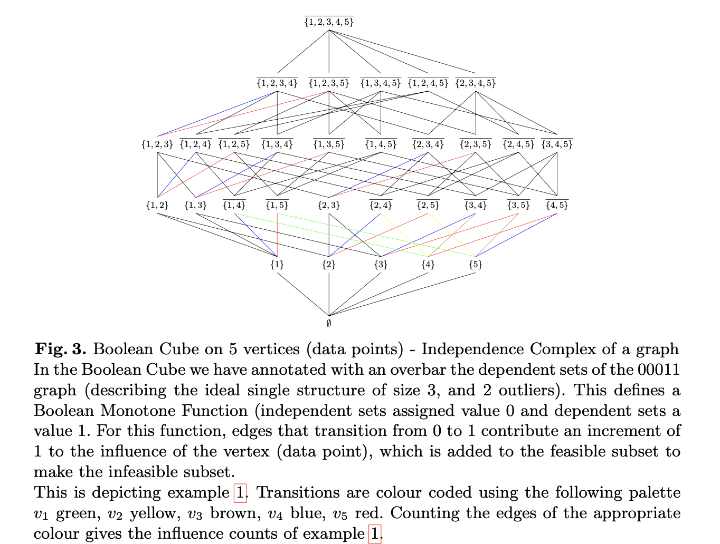

Slide 37
MaxCon | (Hyper)graph Concept
Inlier (to main structure) | vertex that belongs to the Maximum Independent set (of the hypergraph of minimal sized infeasible subsets)
Outlier (to main structure) | vertex that belongs to the Minimum Vertyex Cover (of the hypergraph of minimal sized infeasible subsets)
Feasible set | Member of the independence complex (of the hypergraph of…..)
MaxCon solution | Maximum independent set (of the hypergraph of….)
Ideal Single Structure data | Hypergraph if minimal sized infeasible sets belongs to Complete Split Hypergraph
Essentially single structure data | ?? Split Hypergraph? Maybe some superclass
Inlier/Outlier separable (in principle) by thresholding influence | ?? At least {0,1}*-constructible hypergraphs ….maybe some superset

Slide 38
Special Oracles – that general (Hyper)graph problems do not have
MaxCon | (Hyper)graph Concept
l_infinity fit | Oracle of independence of corresponding vertices – if max residual is less than or equal to epsilon then independent, delse dependent
Cover of a p+1 subset of the data | Subset of vertices that are independent if cover vertices are independent
Consequences – Maximum independent set for maxCon problem is 0(n^{p+1})…..in worst case….(ignoring fixed cost of p+1-sized l_infinity fit and of cover of p+1 subset).

Slide 39
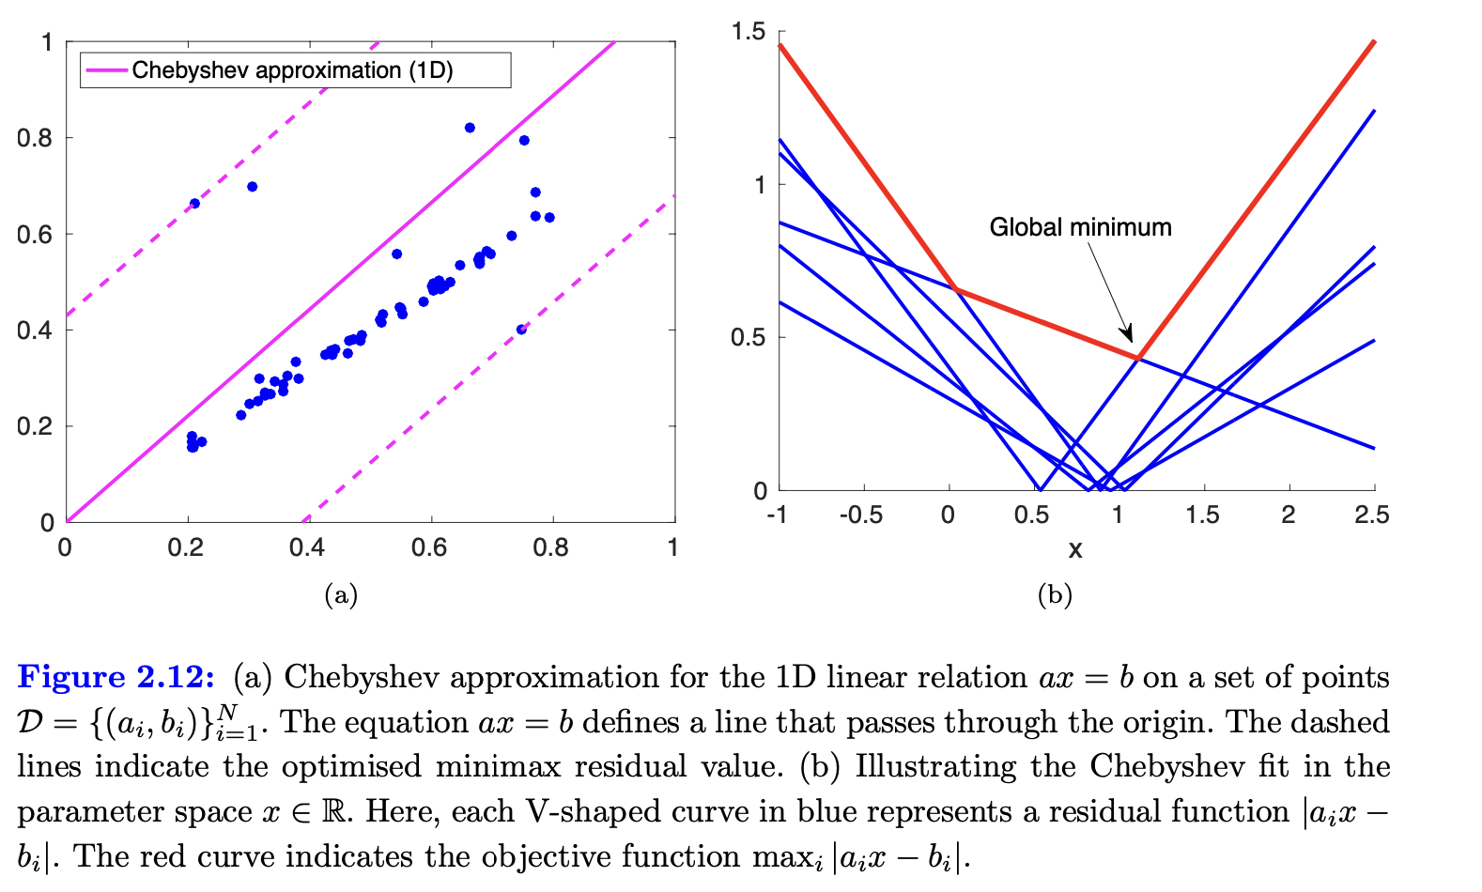
1-D *subspace* model

Slide 40
1D subspace in 2D: y=ax
Ideal single structure – aka complete split graph (infeasible pairs form that graph) 000000000000000000000111111111

Slide 41
Data conforming to ideal single structure aka “complete split”
Greedy finds correct MaxCon solution
Around 47% of the time.
Returns infeasible pair – around 52-53% of the time.

Slide 42
Data conforming to ideal single structure aka “complete split”
Ransac finds correct MaxCon solution around 21-22% of the time.
Returns one inlier– around 32% of the time.

Slide 43
Still essentially single structure – threshold graph 13 swaps from ideal 000000001000000000000011111111

Slide 44
Sizes of inlier sets found by
RANSAC (inner loop) 1000 iter

Slide 45
Sizes of inlier sets found by
RANSAC (inner loop) 1000 iter
MaxCon soln – found about 12% of the time

Slide 46
Sizes of inlier sets found by
RANSAC (inner loop) 1000 iter
Of course always has at least one point. Finds such “solutions” about 26% of time
MaxCon soln – found about 12% of the time
This is data conforming to threshold graph with swap distance 13 from ideal single structure.
000000001000000000000011111111

Slide 47
Greedy algorithm – 1000 iterations

Slide 48
Greedy algorithm – 1000 iterations
Finds correct MaxCon solution about 45% of the time

Slide 49
Greedy algorithm – 1000 iterations
Finds correct MaxCon solution about 45% of the time
Finds a local maxima – the only one – about 4.3% of the time

Slide 50
Greedy algorithm – 1000 iterations
Fails – returns infeasible pair – 50-51% of the time
Finds correct MaxCon solution about 45% of the time
Finds a local maxima – the only one – about 4.3% of the time

Slide 51
Summary of Illustrations and wider data
Ideal single structure aka complete split Success Ransac 32% Success Greedy 47% (theoretically should be 48.28%. More extensive trials averaged over 20x more data (roughly) gives 48.20%
13 steps away from ideal (but still in threshold class)
Success Ransac 12% Success greedy 45%
So far have gathered some summary stats that reasonably well confirm the intuition that:
As one goes from ”ideal/complete split” class to “outer classes” – the hardness of the problem does indeed increase
Where there are some obvious measures of deviation within a class from ideal, the hardness does indeed seem to trend wth the measures.

Slide 52
Within the threshold class – the antiregular graph is in some sense “typical” of greatest distance from ideal. Currently simulated data doesn’t touch antiregular…..i.e., it is very extreme in the distribution of examples typically generated.
But it is useful as as a sort of limit case consideration - *while you stay within threshold” the anti-regular graph would be about as tough as any data in that class could be.

Slide 53
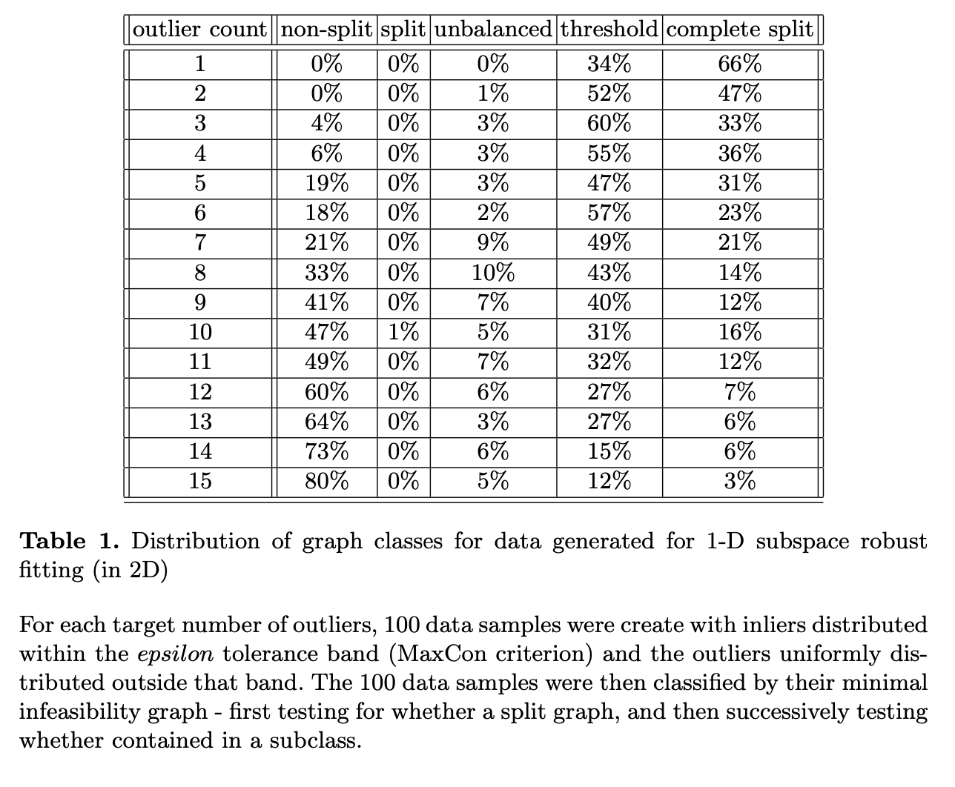
For the *graph* setting many of the test for membership in these classes are cheap – degree tests…or finding isolated or maximally connected vertices and removing…

Slide 54
Hypergraphs
All of this is very nice…..BUT…….
Solving models of the form y=mx (one parameter) is NOT really interesting.
Trouble is…if you have 2 or more parameters, then the the minimal infeasible set size becomes 3 or more….then you are are talking about HYPERGRAPHS and Hypergraph classes (of which, comparatively, little is known).

Slide 55
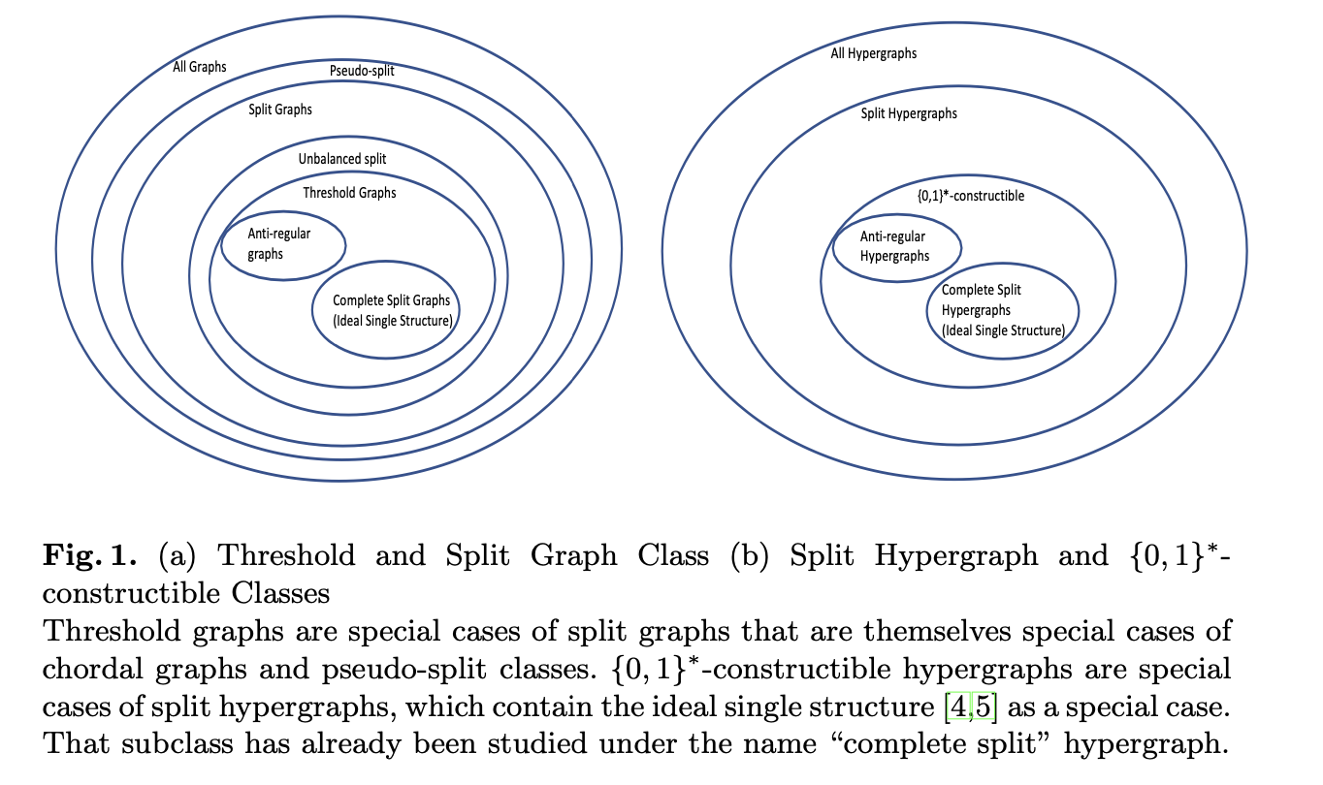

Slide 56
What happens when add a new vertex in {0,1}* constructible (hyper)graphs?
Note – a 3-cube is 2 2-cubes joined by edges “running in the third direction”
This generalizes to n-cubes – an n-cube is 2 (n-1)-cubes joined by edges in the n’th direction
One of these (n-1)-cubes represents all subsets *without* the new vertex (it is the original hypercube before adding the new vertex) – call it the ``lower cube’’
The other (n-1)-cube represents all subsets *with* the new vertex

Slide 57
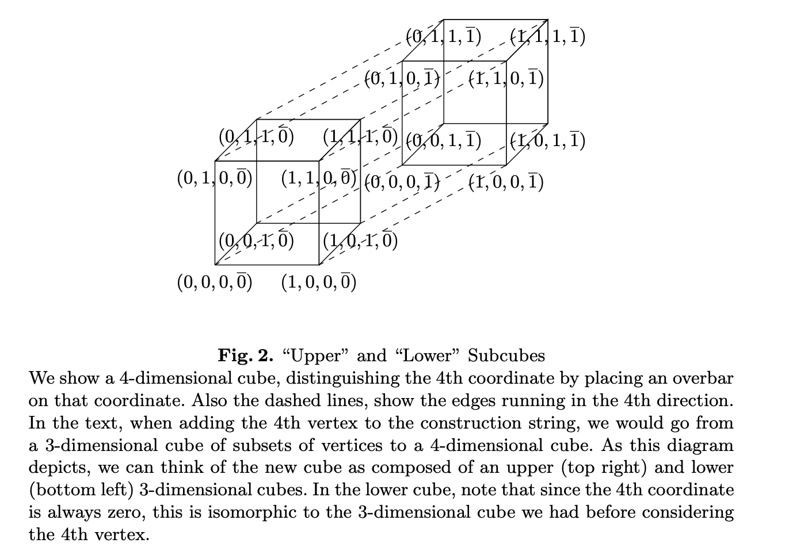

Slide 58
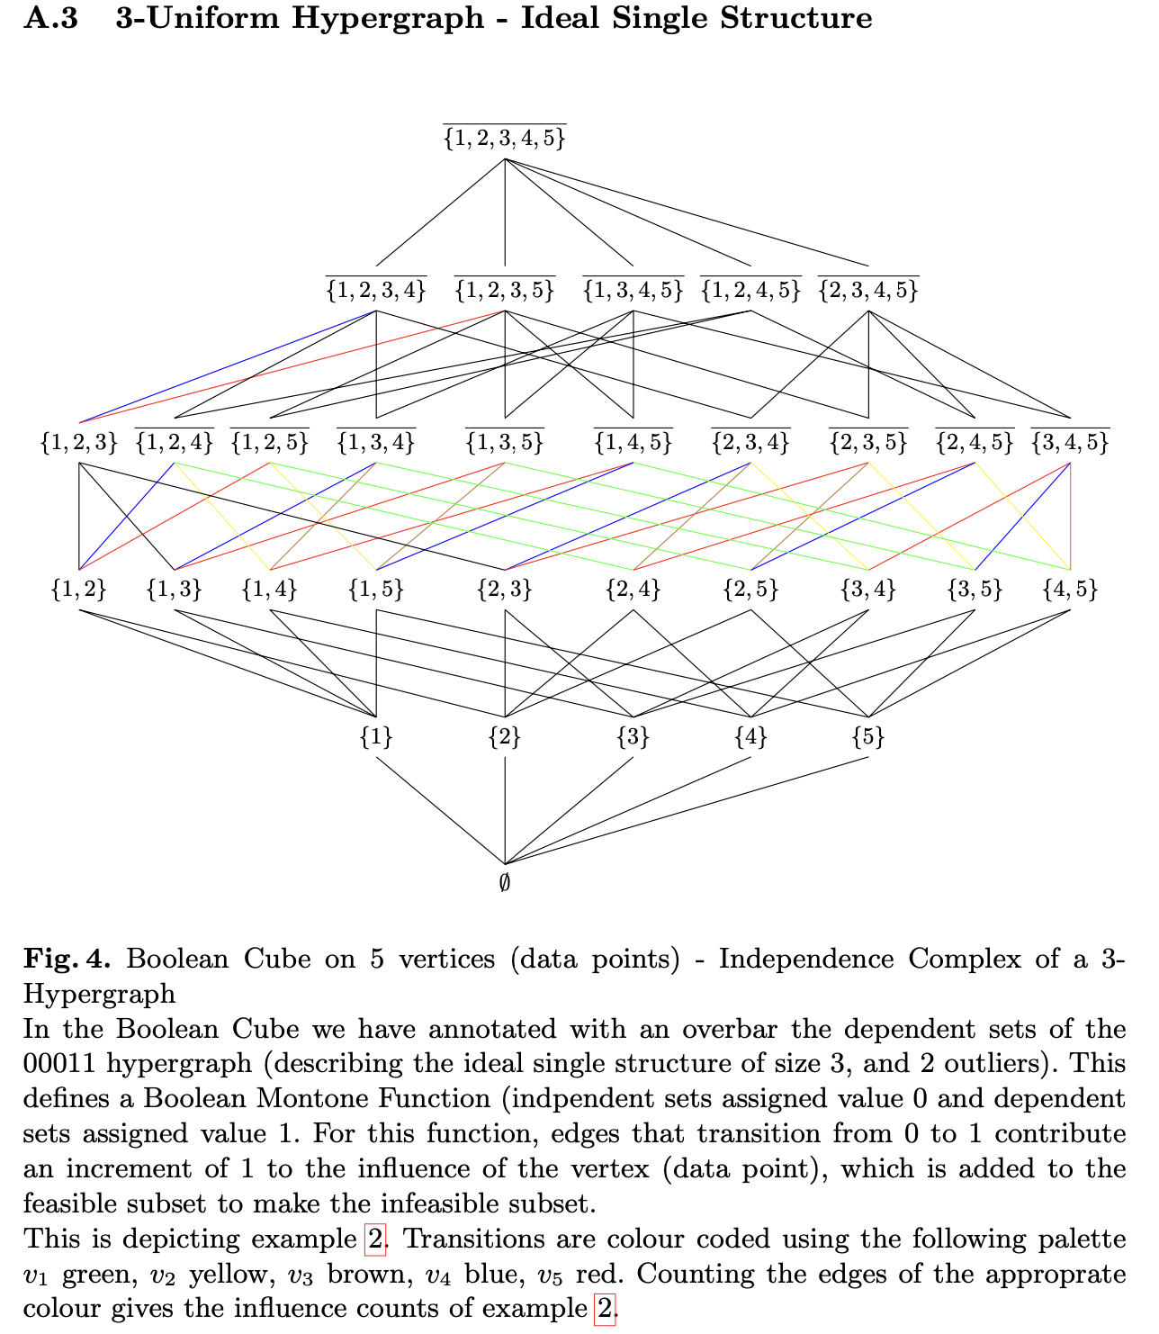

Slide 59
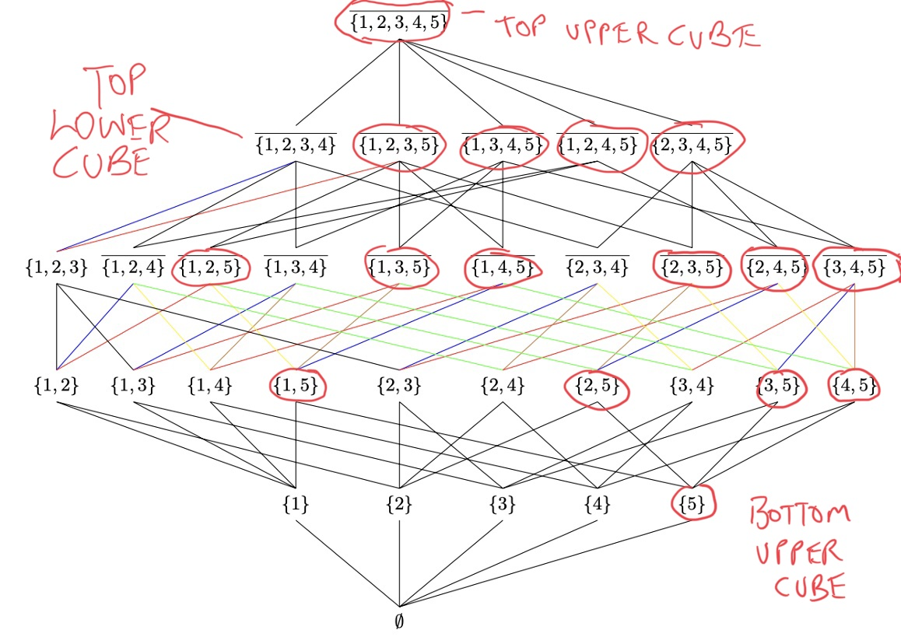
Pivotal edges from “flipping membership of 5” are coloured in red – note these are the (only) edges between the lower and upper cubes…

Slide 60



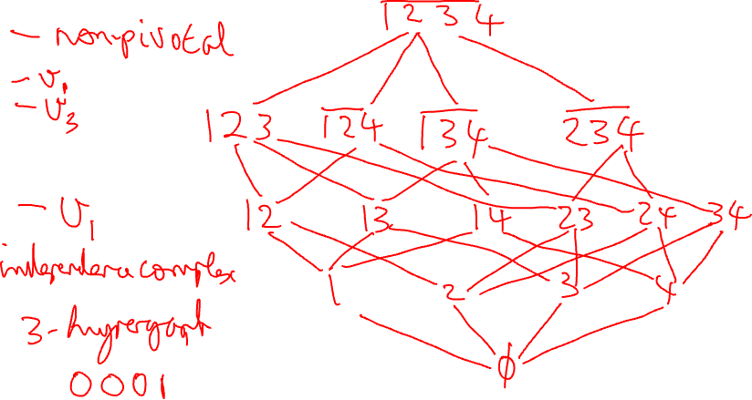
(The lower cube of EITHER a) independence complex of 00010…. OR 00011… constructible hypergraphs

Slide 61





Upper cube if added an isolated vertex…

Slide 62
Effect of adding an isolated vertex
New vertex has zero influence value – doesn’t cause ANY transitions from independent to dependent or visa versa
Essentially creates a “COPY” of the lower cube (except each node of the cube now has an additional element – the added vertex)
So double the number of pivotal edges (of each type…for preceeding vertices)
The number of non-tri vially independent sets more than doubles – doubles + some additional that can carefully count (see later)

Slide 63
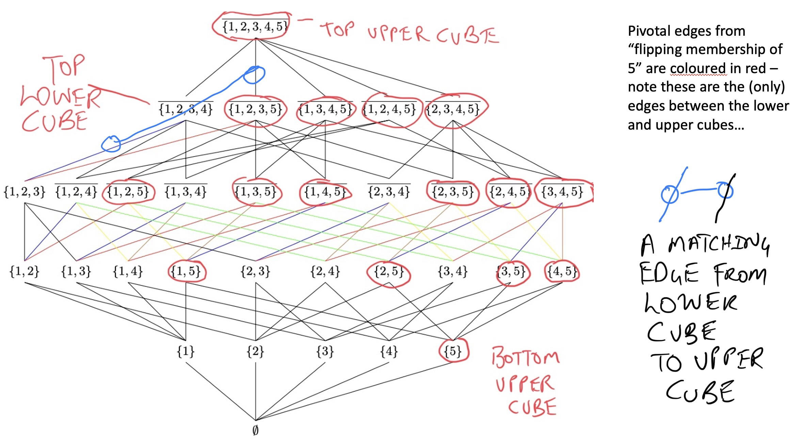
No longer a pivotal edge in upper cube ….

Slide 64
Only pivotal edges in lower cube are from size 2 to 3 nodes – where addition of ANY member will lead to a node of size three containing a 5

Slide 65
So…when adding a dominating vertex…
Lower cube always stays as was (also true for adding an isolated vertex of course)
There are no non-trivially independent sets in the upper cube (they all contain an edge of the hypergraph because 5 makes edges with every choice of p vertices (for p+1 uniform hypergraph)
So there are NO pivotal edges in the upper cube except between level p and p+1
EVERY edge between level p and p+1 in the upper cube is pivotal – these are the “extra” contributions to the count of influences…

Slide 66
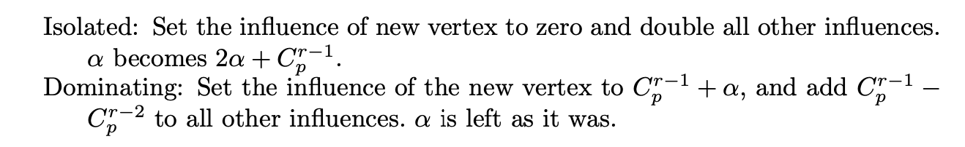
Incrementally computing influences of {0,1}* hypergraphs:
Keep track of “non-trivial” independent sets (alpha).
Initialise alpha to 0
Decode the construction string and update influences by…

Slide 67
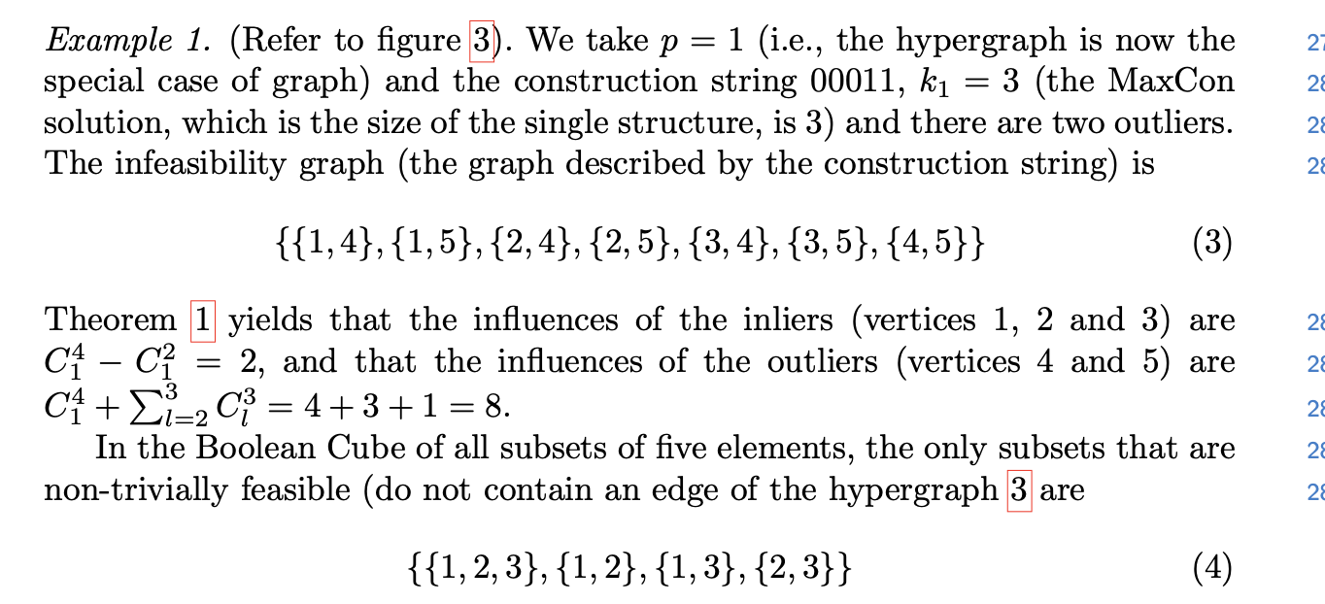

Slide 70
In addition to allowing incremental calculation…
The above rules show that
addition of isolated vertices preserves order of influences, doubles “gaps”
addition of dominating vertices preserves order of influences but does not double gaps
The above are “un-normalized” edge counts. Estimation involves normalised (weighted by inverse of total edges for uniform measure) counts. The total number of edges doubles with adding a new vertex.
So….isolated vertices preserve “normalized gaps”.
Dominating vertices usually diminish gaps…so large numbers of outliers makes estimating the separation inlier/outlier harder…justifies the empirical decision to estimate – remove largest – re-estimate paradigm of CVPR2021/22.

Slide 71
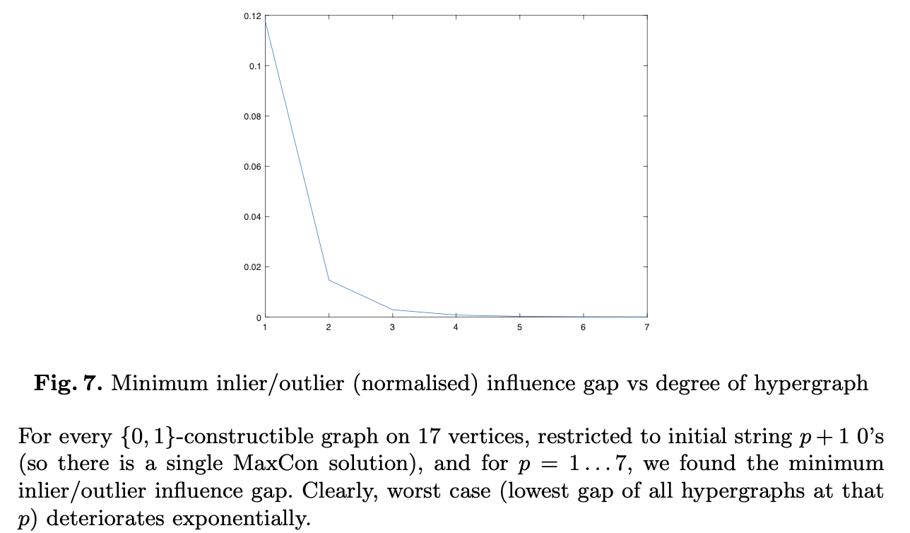
Also degree of hypergraph matters….

Slide 72
Limitations….
Picture for hypergraphs is very incomplete
Even where we know something about the structure of hypergraph classes relevant to our purposes – all computation seems heavy (testing membership of the class for example). In contrast, most of the graph classes that played a part in earlier slides have simple degree sequence tests for membership etc.
So far, have limited experimental evidence of the relationship between graph class hierarchy and computational hardness (toy problems) or limited (to influence-type approaches) theoretical results.

